Slide 1

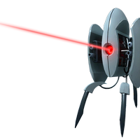
Artificial Intelligence in Games
Drew Clinkenbeard
Krzysztof Pietroszek
* Based on slides by Arnav Jhala, UCSC

Slide 2
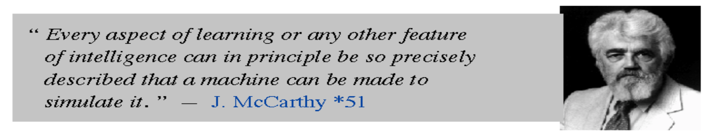
Artificial Intelligence
Goal: [Turing 1950] Program a computer to exhibit intelligent behaviour.
1960s very optimistic
Reality: Slow progress with some major successes

Slide 3
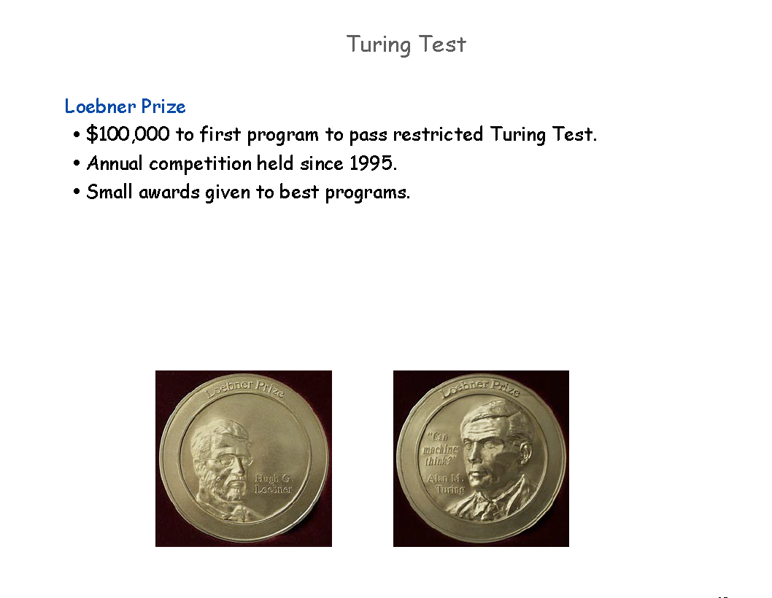

Slide 4
Turing Test
Judge types a question to a computer and a human
Pass: If the judge can't tell which is human…
Turing predicted that a computer would pass by 2000
The Loebner Prize was won in 2006 by Rollo Carpenter
Rollo also made Cleverbot...

Slide 5
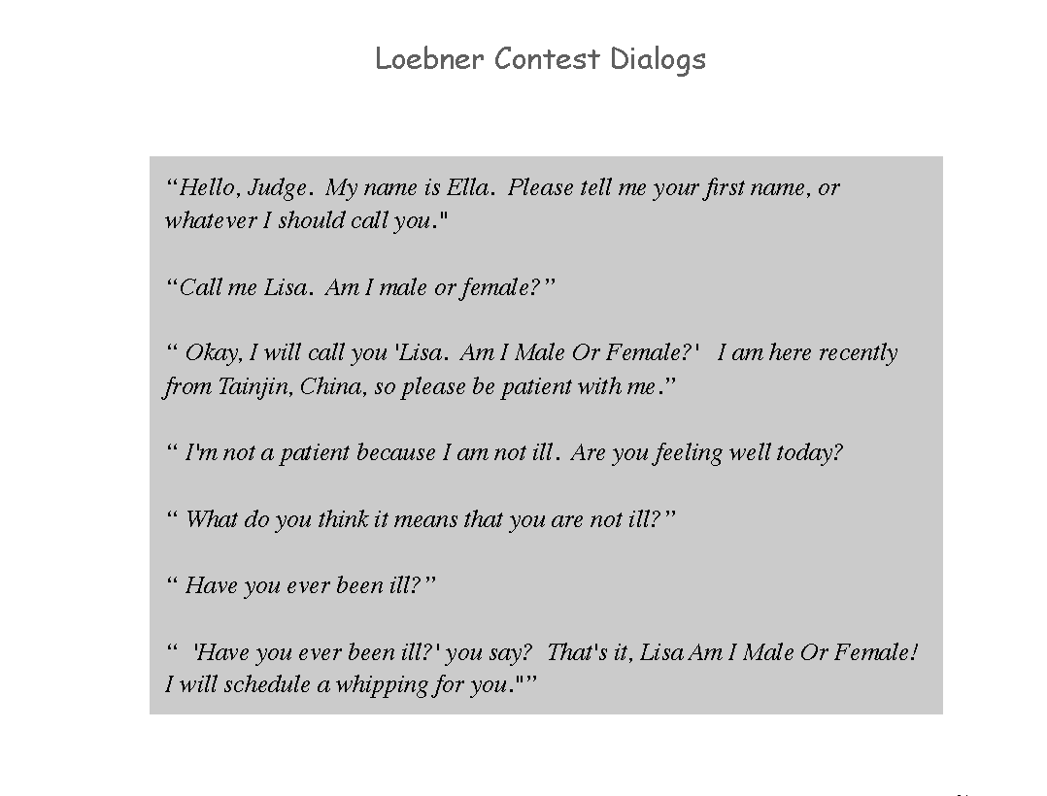

Slide 6
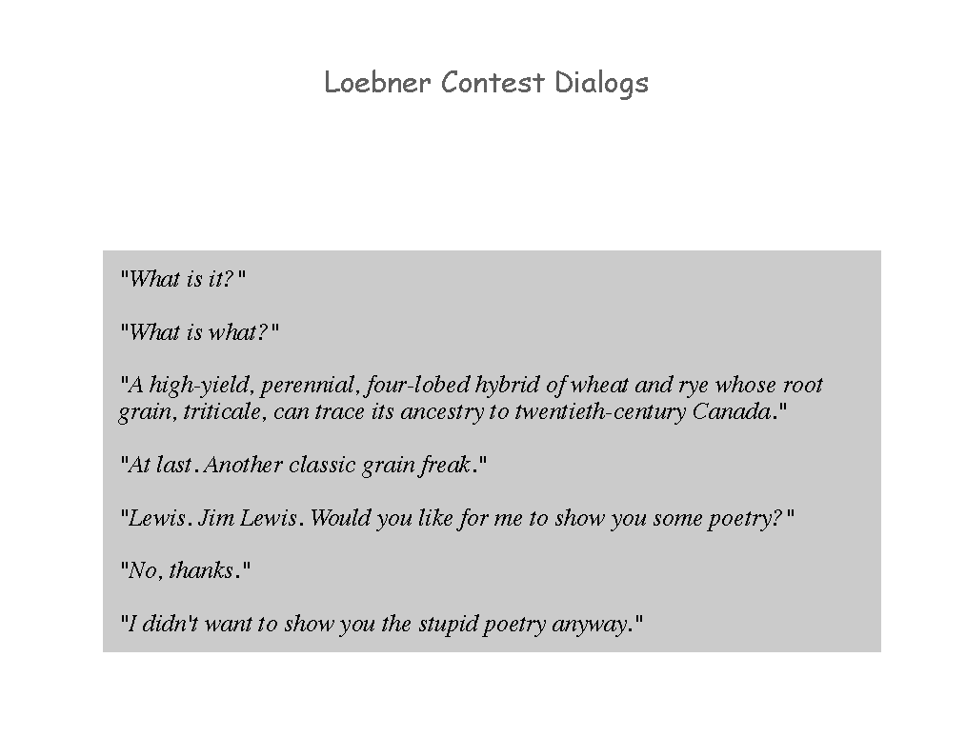

Slide 7
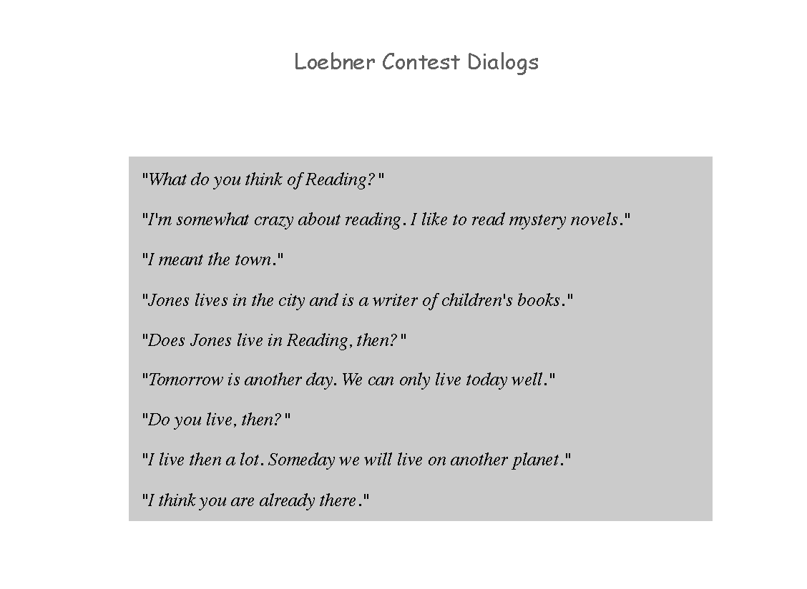

Slide 8
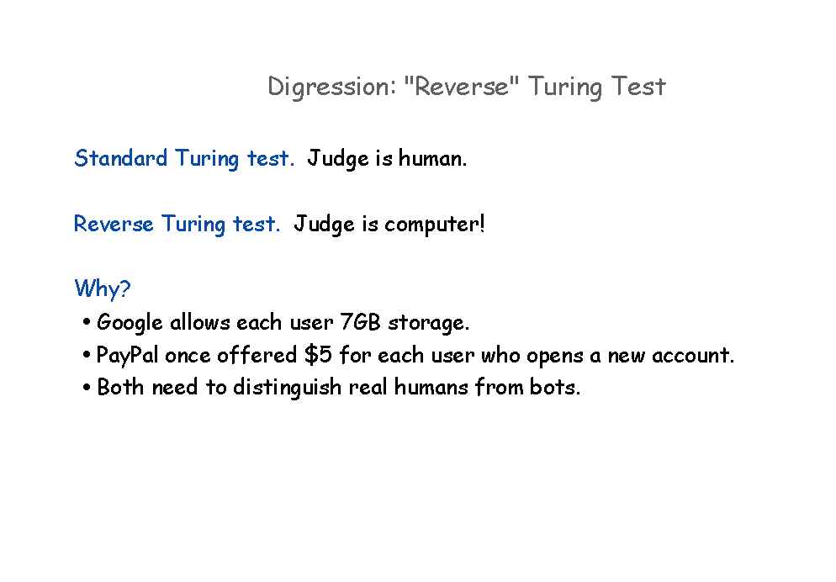

Slide 9
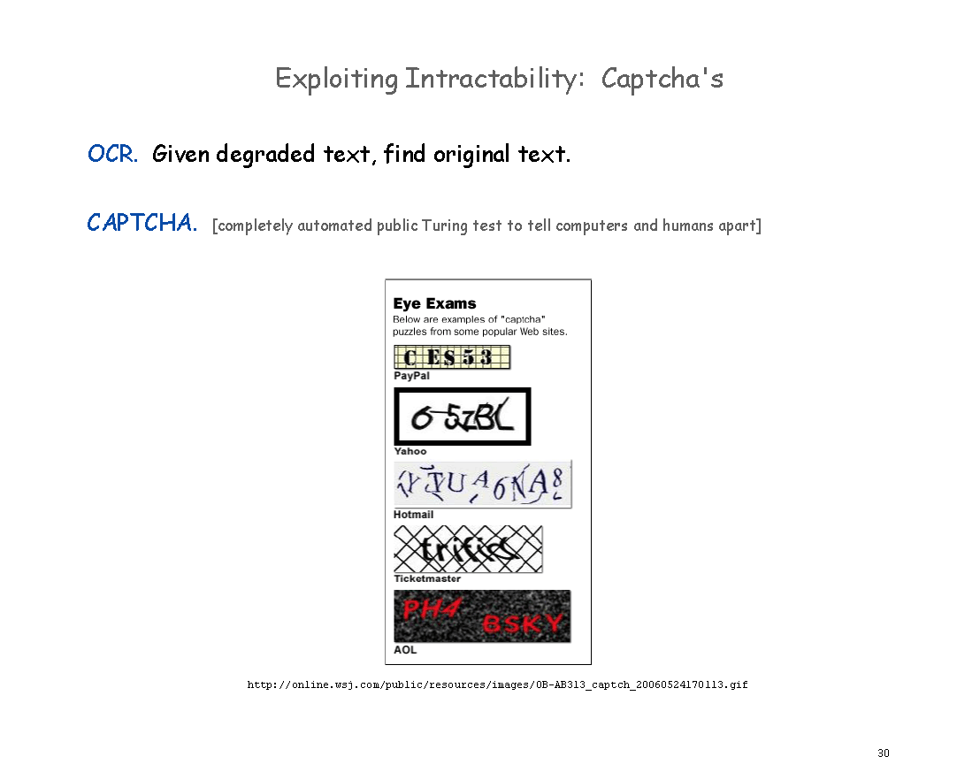

Slide 10
A brief interlude from John Mulaney
https://youtu.be/en5_JrcSTcU?t=337

Slide 11
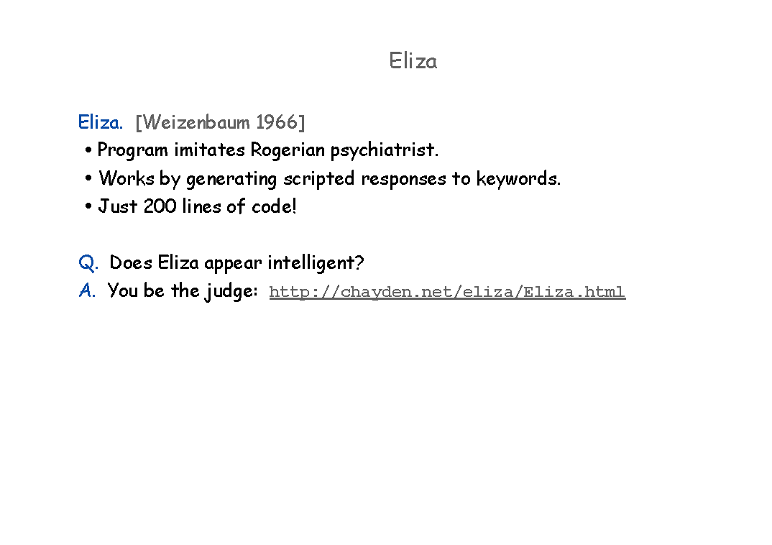
http://chayden.net/eliza/Eliza.html
http://manifestation.com/neurotoys/eliza.php3/

Slide 12


Eliza and Perry
Eliza was an AI created in 1966(!) to simulate a psychologist
Uses scripted responses to key words
Only 200 lines of code
Perry was a similar program designed to imitate a paranoid schizophrenic

Slide 13
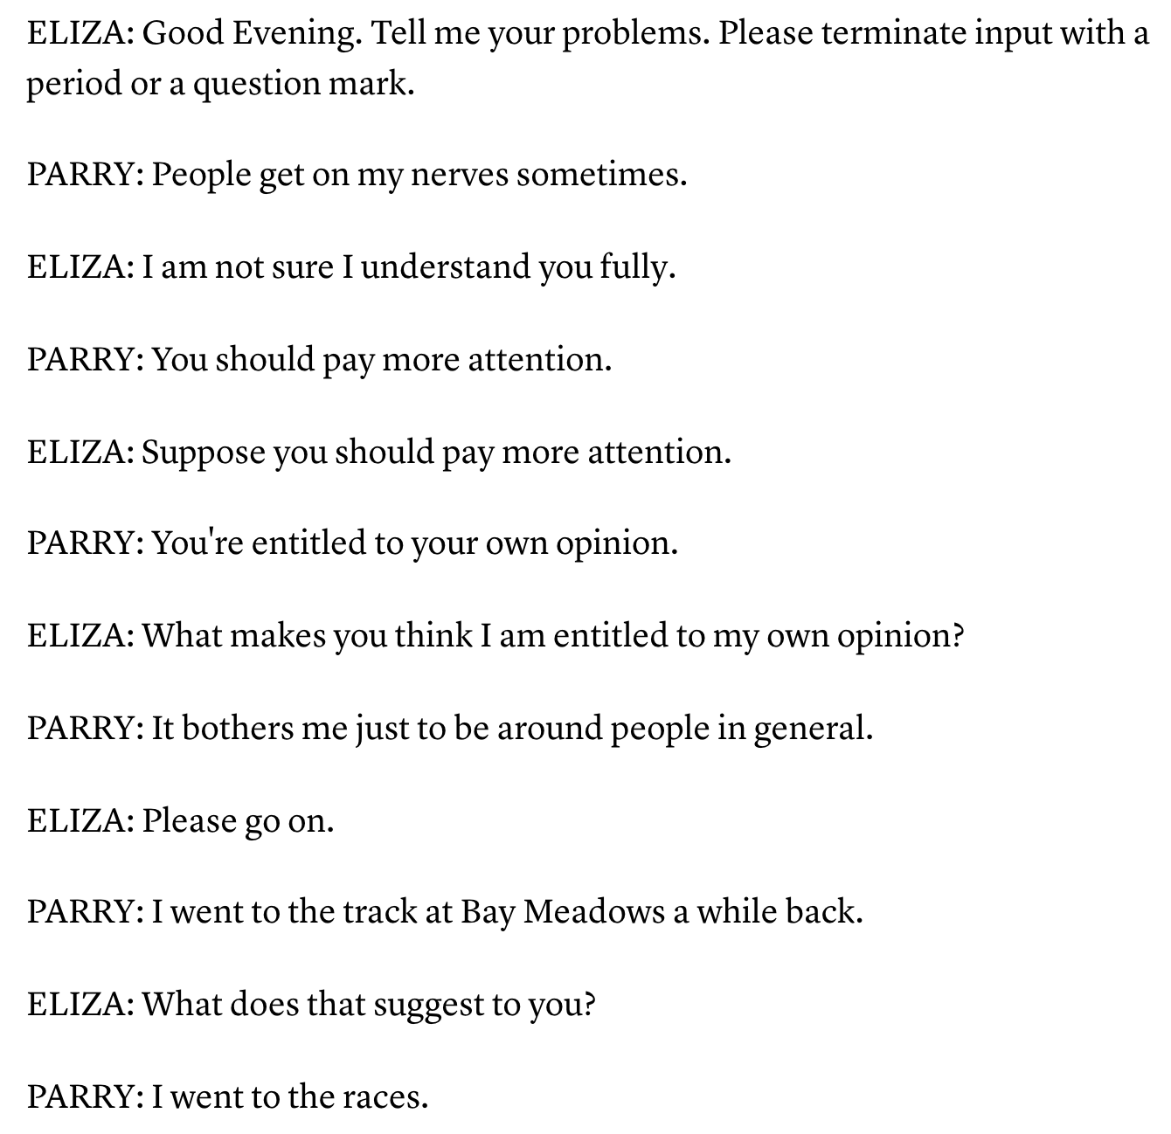
https://tools.ietf.org/html/rfc439
https://www.theatlantic.com/technology/archive/2014/06/when-parry-met-eliza-a-ridiculous-chatbot-conversation-from-1972/372428/

Slide 14
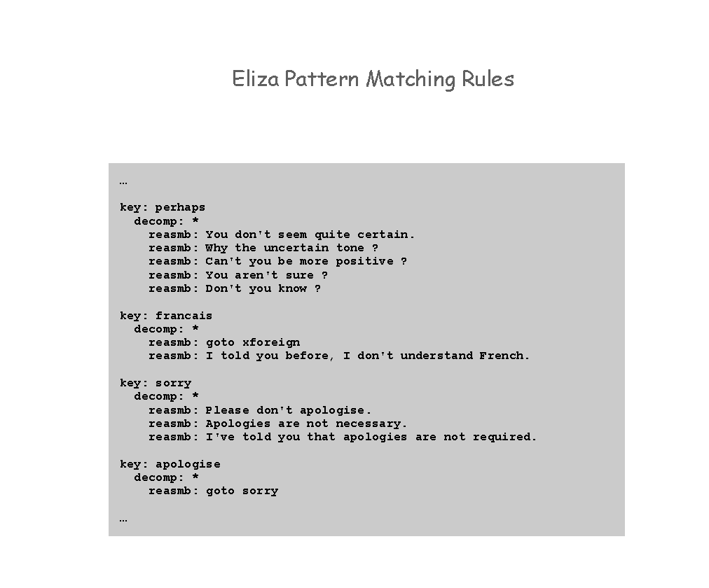

Slide 15
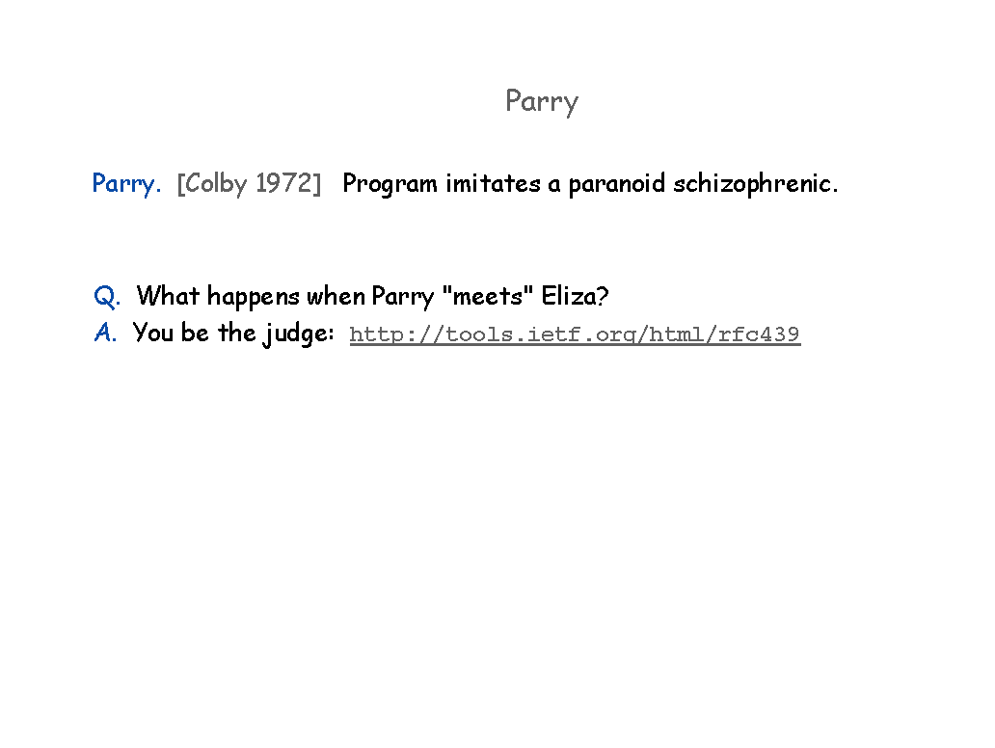
https://tools.ietf.org/html/rfc439
https://www.theatlantic.com/technology/archive/2014/06/when-parry-met-eliza-a-ridiculous-chatbot-conversation-from-1972/372428/

Slide 16
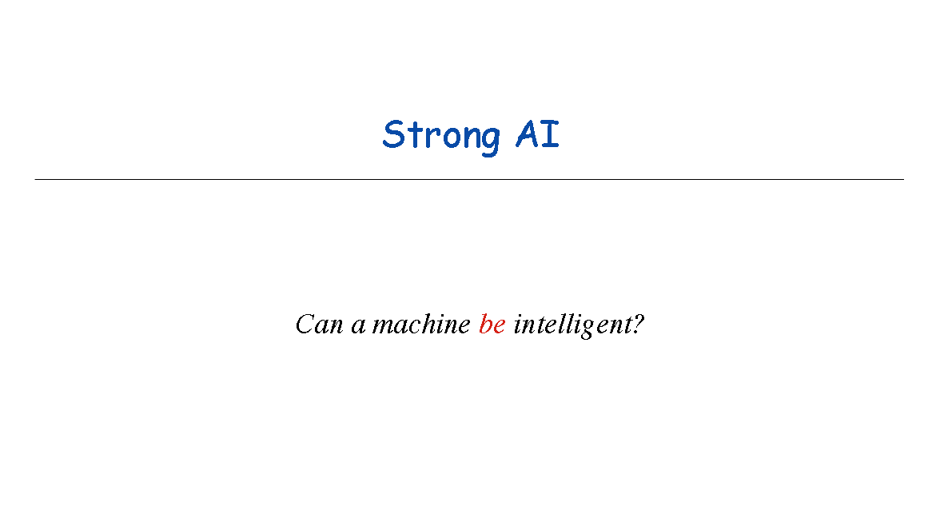

Slide 17
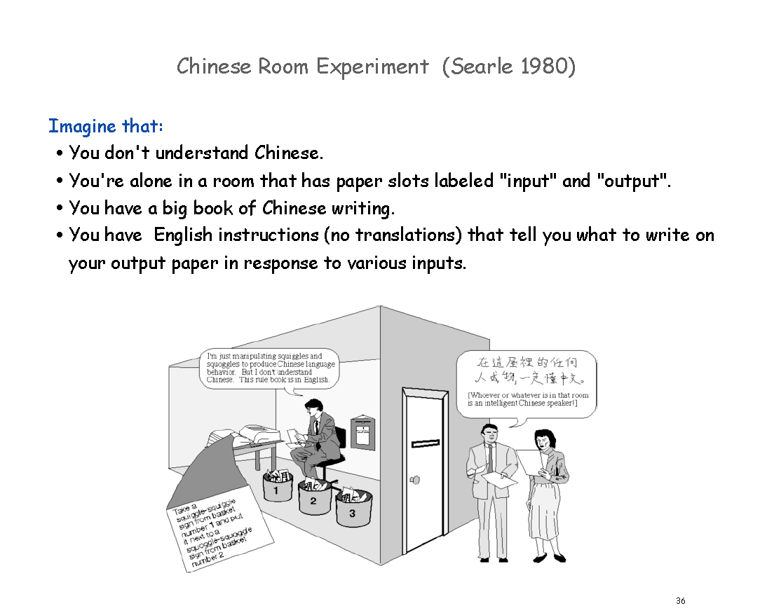

Slide 18
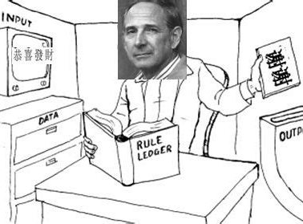
Chinese Room Experiment
(Searle 1980)
Imagine
You don't understand Chinese
You get a job to sit in a room with an inbox and an outbox
You have a giant book of Chinese writing
You have a single sheet of english instruction that reads: if you see diagram A write diagram B

Slide 19
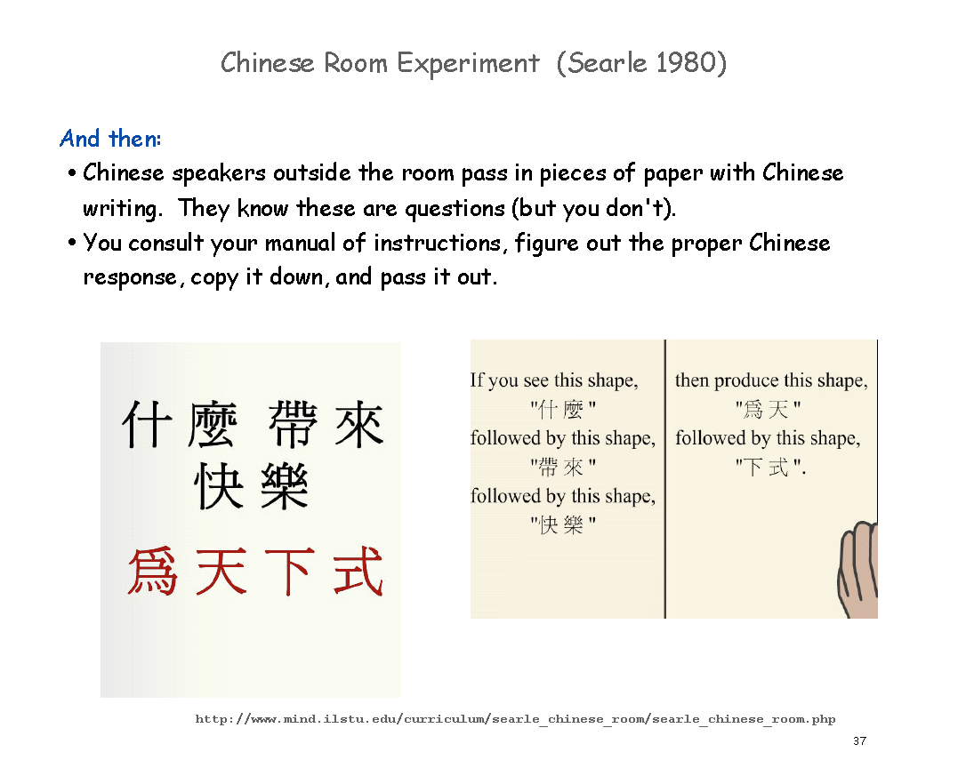

Slide 20
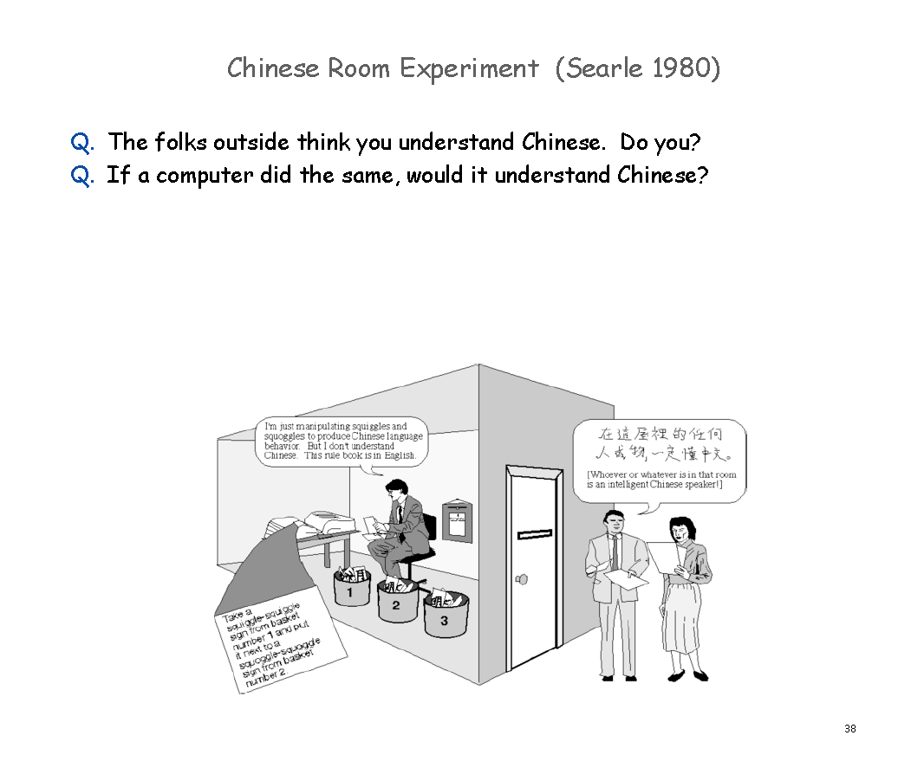

Slide 21
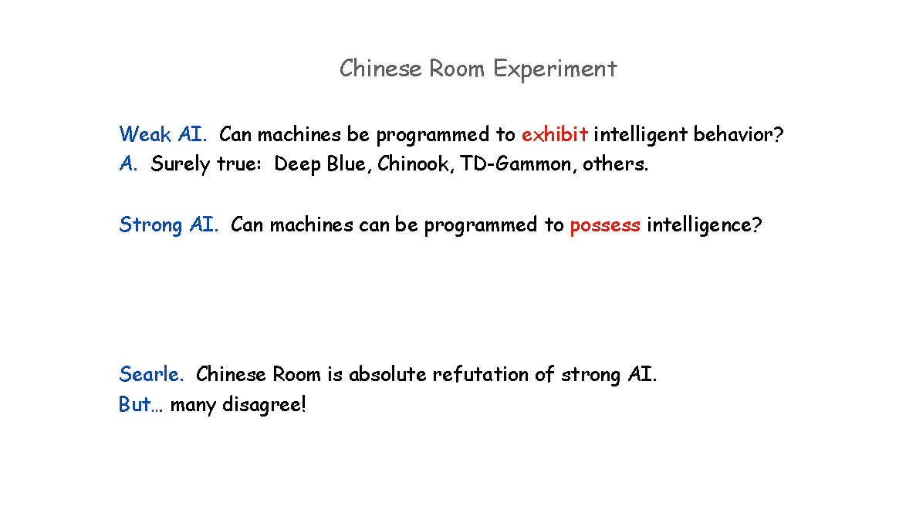

Slide 22
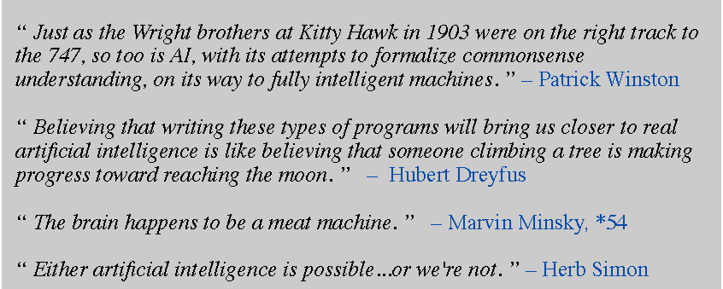
Is (Strong) AI Ultimately Possible?

Slide 23
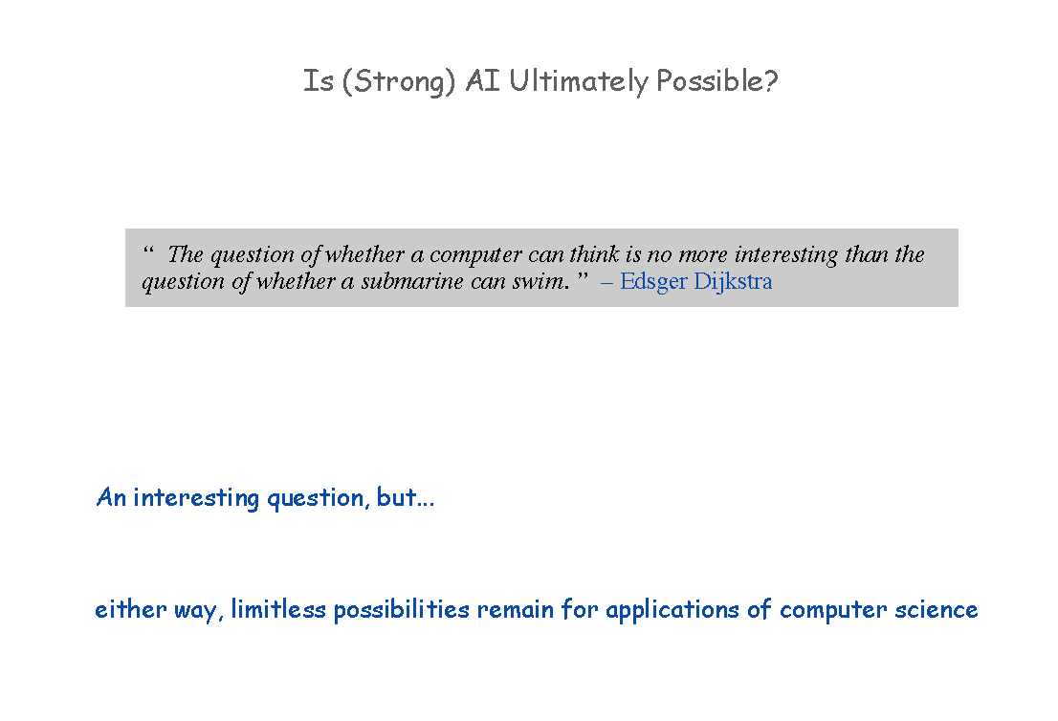

Slide 24
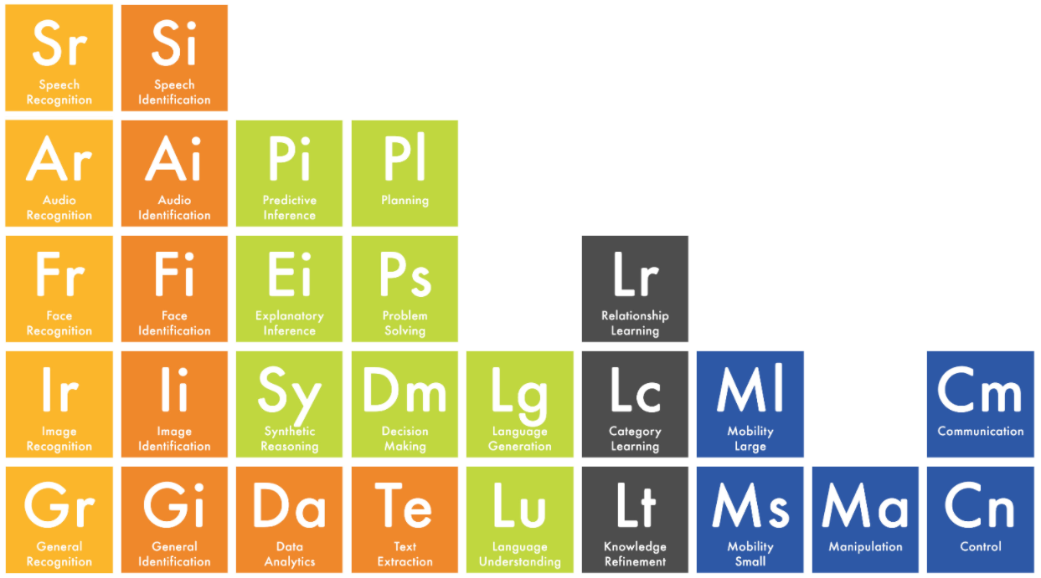

Slide 25
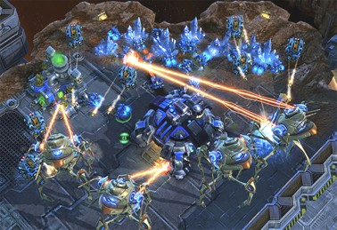
Games
Rules
Skills
Ranking (evaluation and comparison metric)
Learning
observation
demonstration
teaching

Slide 26
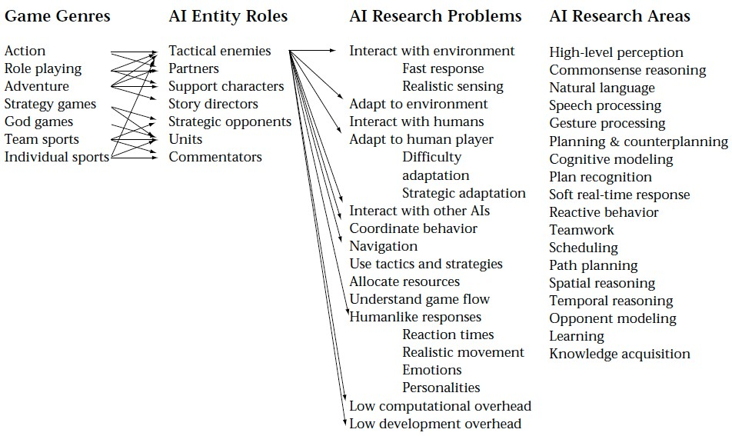
AI use in Games

Slide 27
Goal Game AI
Modern video games AI Goals
illusion of believability; often a design problem
experience management
Make mistakes that look “human-like”

Slide 28


Problem Environment Properties
Chess StarCraft Taxi Driving
Fully vs. partially observable | Fully | Partially | Partially
Deterministic vs. stochastic | Deterministic | Deterministic* | Stochastic
Episodic vs. sequential | Sequential | Sequential | Sequential
Static vs. dynamic | Static | Dynamic | Dynamic
Discrete vs. continuous | Discrete | Continuous | Continuous
Single vs. multiagent | Multi | Multi | Multi

Slide 29
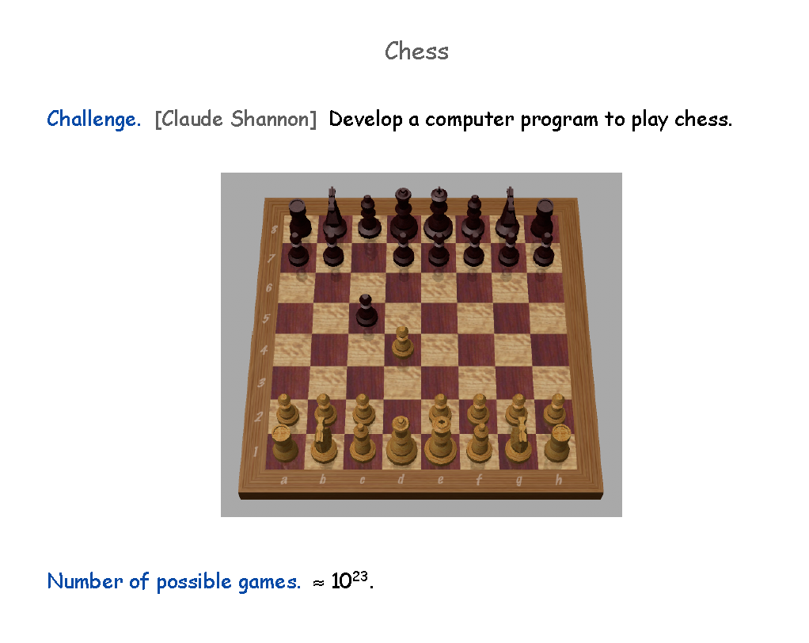

Slide 30
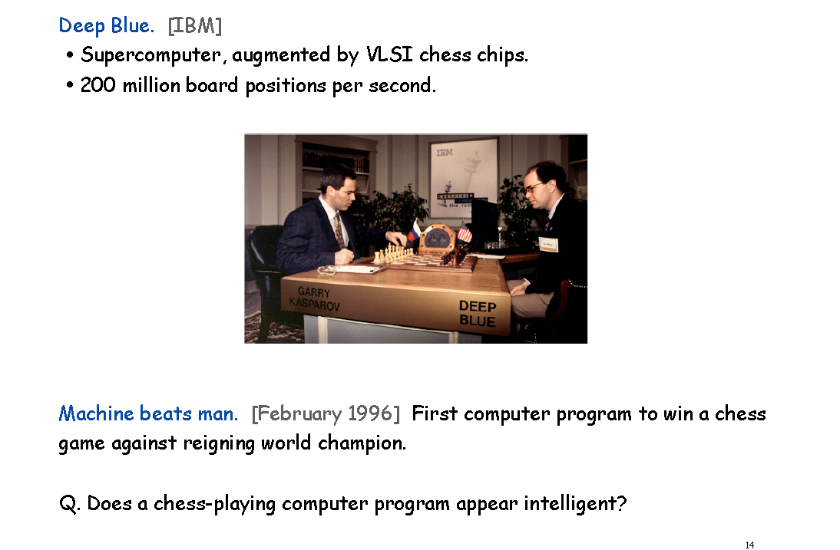

Slide 31
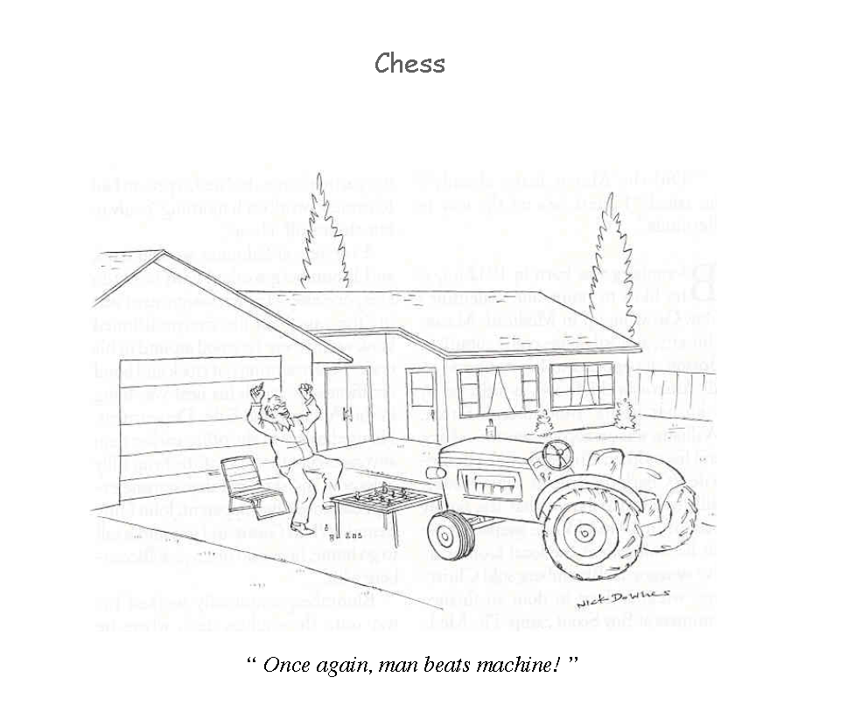

Slide 32
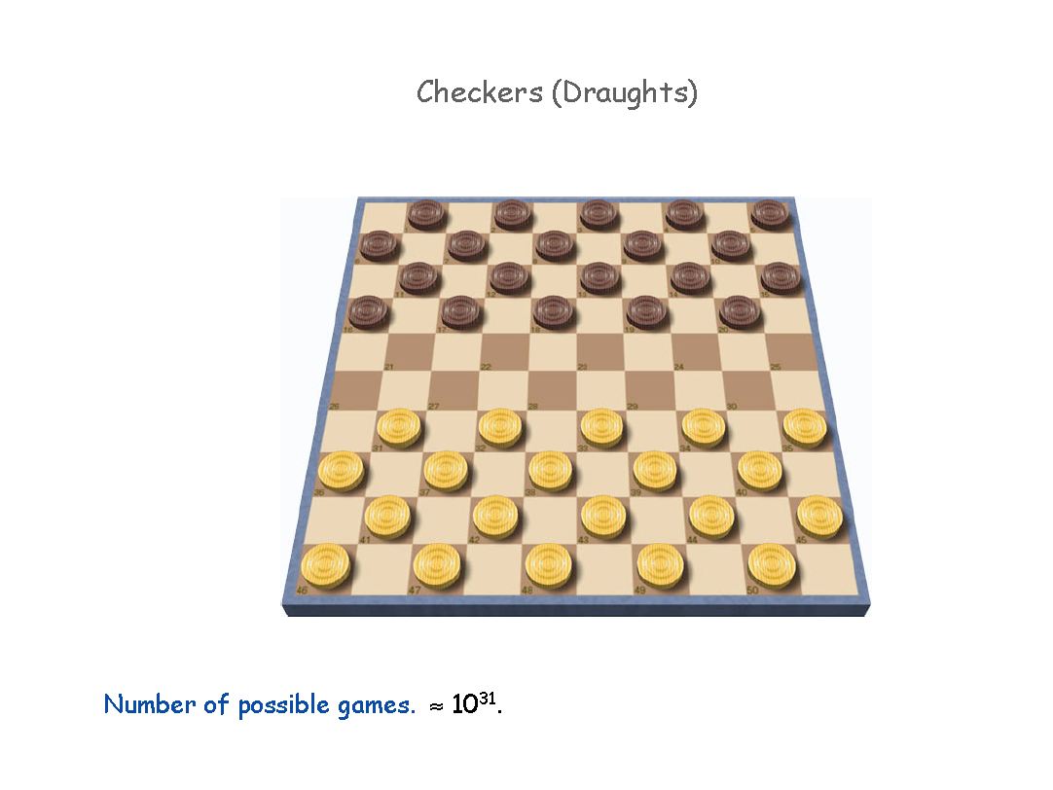

Slide 33
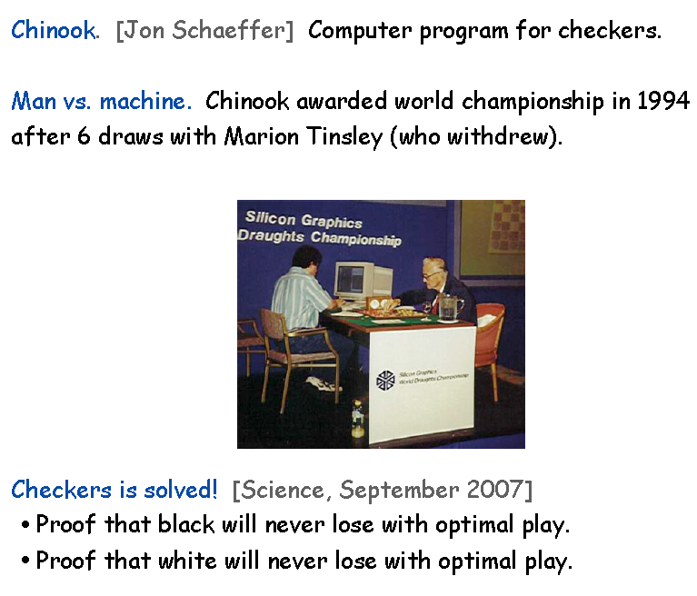

Slide 34
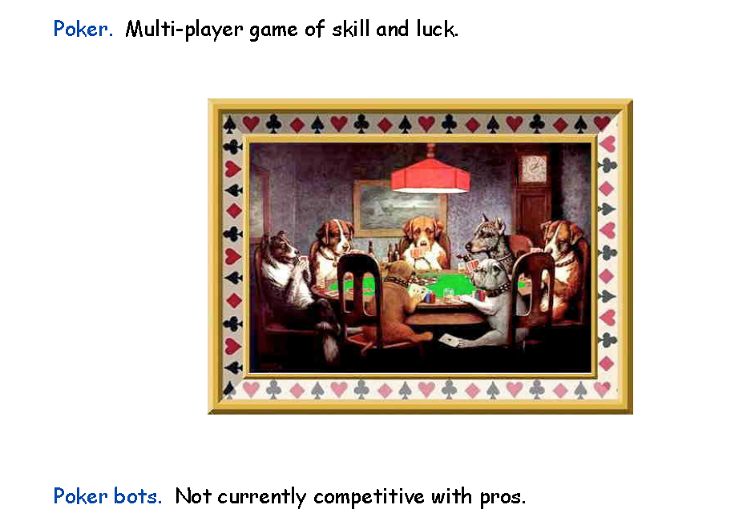

Slide 35
Game AI - approaches
Problem-centric
Path-planning
Dialogue generation
Camera control
Technique-centric
Machine Learning
Planning
Hybrid
General game playing

Slide 36
Computer as
Player
Character
Opponent/Friend
Assistant Designer
Designer
Tester/Critic

Slide 37
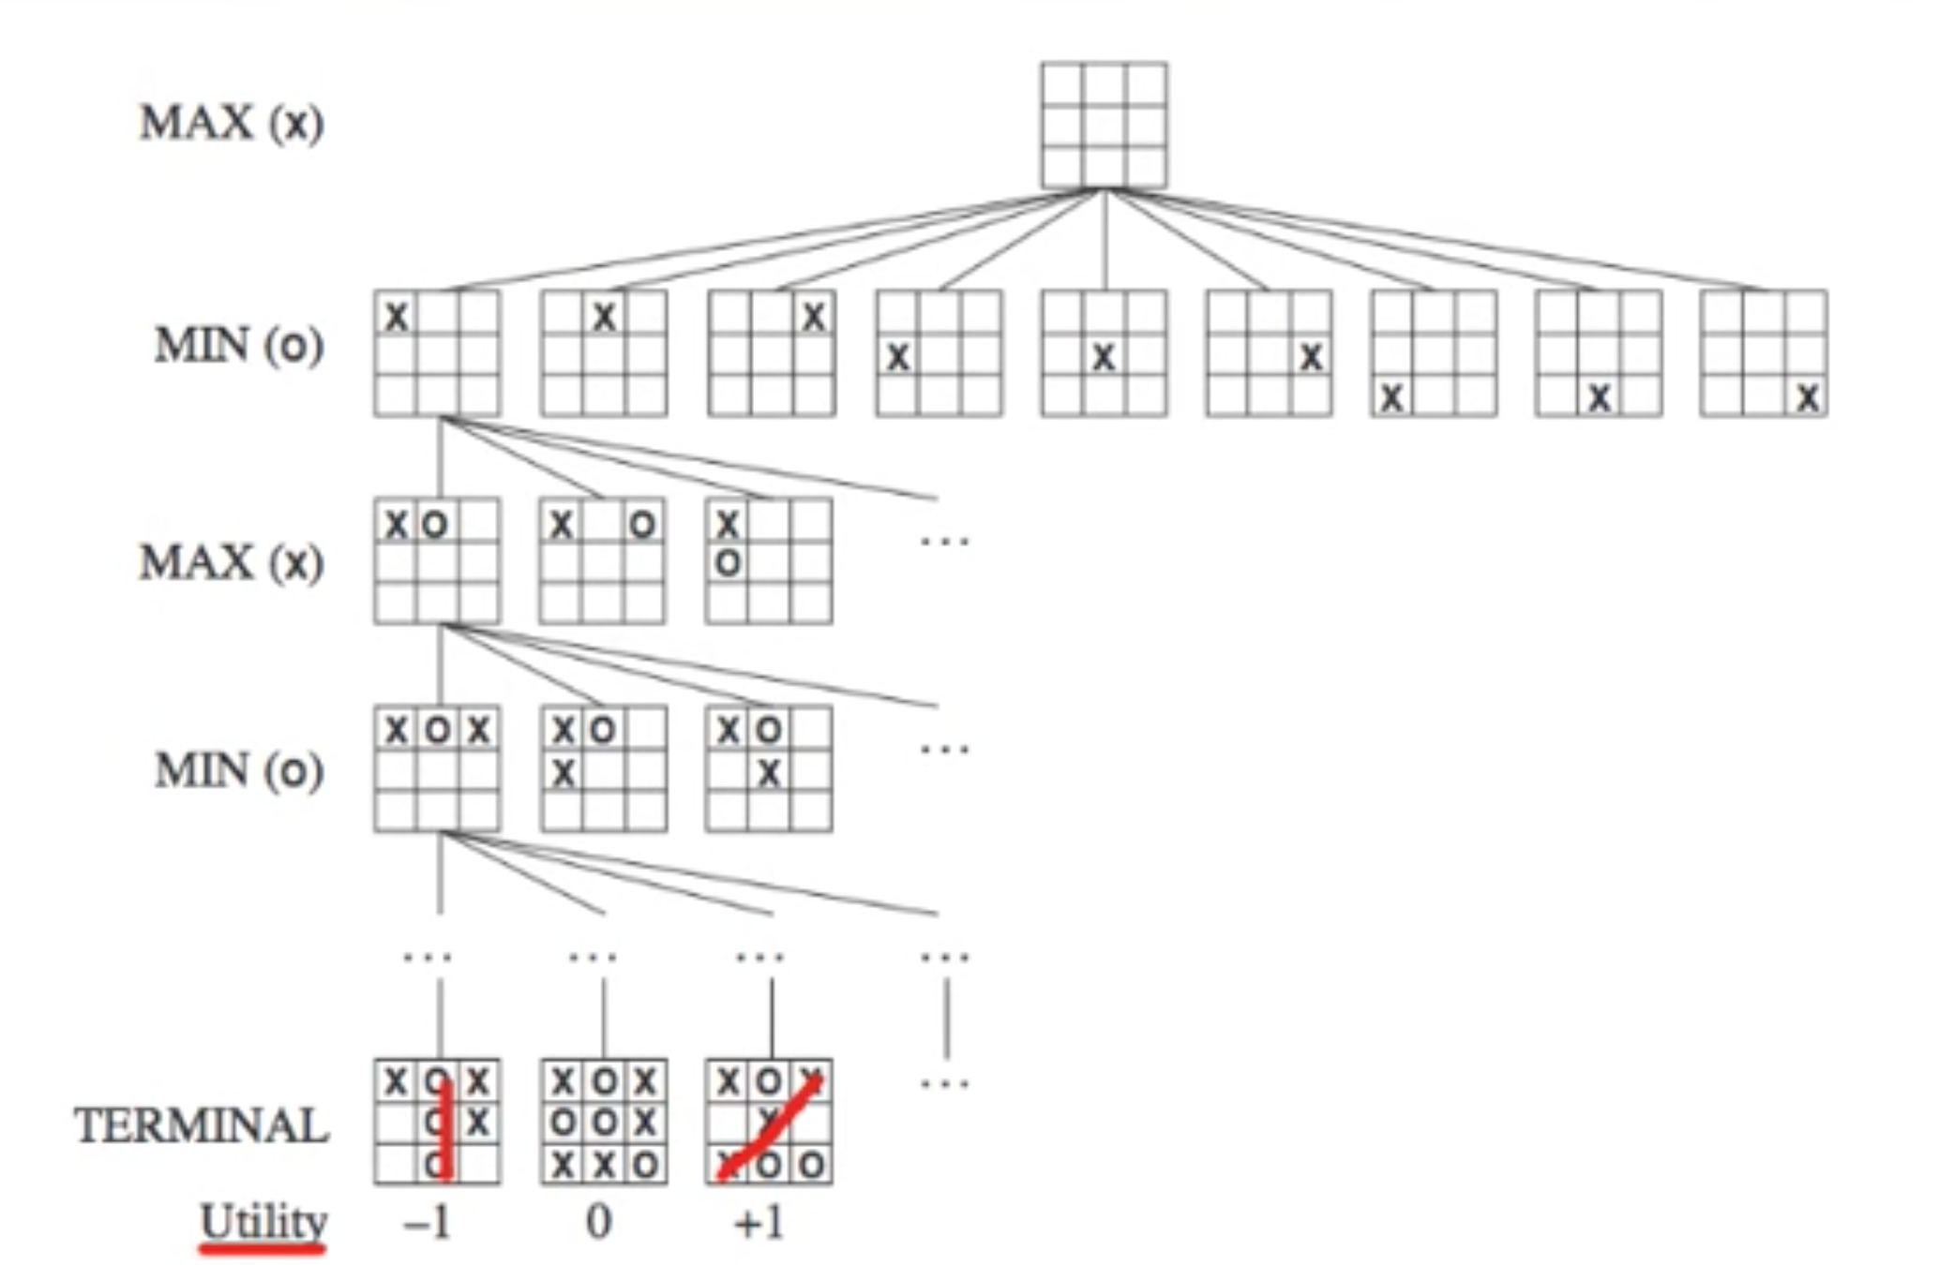
Computer as Player: TicTacTo AI
MiniMax exhaustive search

Slide 38
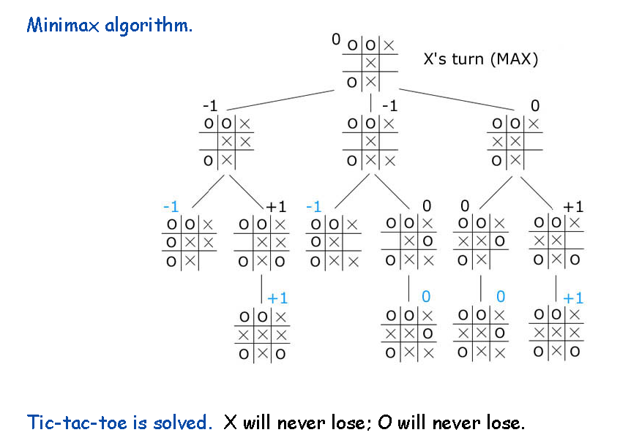
Computer as Player: TicTacTo AI

Slide 39
Computer as Player: TicTacTo AI
MiniMax exhaustive search
Always wins (that’s BORING!)
Exercise:
Understand the provided code.
Change it so AI does not always win, but still plays „correctly”. For example, it does not override you move.
Can you control the probability of computer winning? For example, make computer win at, roughly 30% of times.

Slide 40
Finally...
https://youtu.be/_sBBaNYex3E
and
https://www.youtube.com/watch?v=kHBcVlqpvZ8

